Slide 1
Redefining Risk
A look at your business from your underwriter’s point of view

Slide 2
Introduction
ASG Programs from EPIC provides bowling center insurance through our Sports & Recreation Facilities program with HCC Specialty.
Started in 2009, we now write over 4M in bowling premiums countrywide
Our Carrier is the endorsed BPAA Smart Buy for Insurance

Slide 3
Agenda
Introduction to Risk Management Bowling Center Specific Exposures Ancillary Activity Exposures – The Family Entertainment Center Common Coverage Gaps for Many Bowling Centers No-Fault Coverage Explained GL Coverage Limits Mitigating Your Exposures Optional Coverage Considerations

Slide 4
Introduction to Risk Management Basic coverages that make up your business policy: Commercial Property: Building Coverage – coverage protects against physical damage to the building or structure itself. Typically includes permanently installed fixtures and equipment such as the lanes, ball returns, and pinsetters. Contents- Covers business personal property not included in above against physical damage. Includes stock held for sale. Equipment Breakdown (Boiler and Machinery) – coverage for loss due to mechanical breakdown of equipment (computers, HVAC systems, electrical equipment, etc.). This covers physical damage as well as business interruption and extra expense. Commercial Crime – coverage for losses due to crimes such as employee dishonesty, forgery, computer fraud, and money and securities coverage. Business Income - loss of net income due to damage to premises by a covered cause which causes a slow down or suspension of operations. (continued on next slide)

Slide 5
Business Income Insurance Coverage is an important but often misunderstood coverage. Following a major loss, there are lots of things that a business can do without... revenue isn’t one of them. Business income coverage is a type of property insurance that is designed to pay for loss of net income that occurs when a business suffers major physical damage to their property and forced to completely or partially suspend business operations. Coverage is provided for the time it takes to rebuild, repair, or replace the damaged property or the period of restoration. This insurance works in conjunction with your property policy and provides coverage for events beyond your control such as wind, hail, fire, vandalism or damage from vehicles or aircraft that may interrupt your business.
How does Business Income Coverage protect you?
If you have a covered property loss and your business is forced to close temporarily, business income coverage will:
Compensate you for net income (profit or loss before income taxes) you would have incurred or earned had a covered loss not occurred.
Pay for continuing expenses- such as mortgage, taxes, payroll, and insurance
Continuing expenses are normal operating expenses that may continue during the period of restoration and extended period of indemnity.
Pay for relocation expenses and advertising costs if you set up shop at a temporary site

Slide 6
How to Calculate your Exposure
Determine How Long You Will Be Out of Business
The first thing you need to figure out is exactly what you would do if your facility were damaged or destroyed. Would you retire? If so, BI coverage may not be for you.
However, if you want to remain in business, then you would need to decide how long it would take you to get up and running again (the Period of Restoration). Would you suspend operations until you could reoccupy your current location? The answer would be yes for bowling center owners.
Would you search for an alternative permanent location? Could you use other premises to partially resume operations until your new permanent location is available? For bowling center owners this would very unlikely.
Determine Your Loss of Profits
The second step is to determine what your loss of net profits would be during the Period of Restoration.
Determine Your Continuing Operating Expenses
Third, what would your continuing operating expenses be?
A major category of continuing operating expenses is payroll. You have the option of including or excluding “Ordinary Payroll.” Ordinary payroll is defined as “payroll expense of employees other than executives, department managers, employees under contract and other important employees.”
Your “ordinary” employees are important to your operation, you may want to keep them on your payroll until you are ready to reopen. Additionally, you can specify how long you might want to include them (i.e., 30, 60, 90 or 180 days). If you decide to exclude ordinary employees all together, this would lower business income amount that should be carried.
Once you have determined your monthly exposure and how long it would take to get back in business, you multiply your monthly exposure by the number of months it will take to get back in business, which produces your Business Income Valuation for the period of restoration

Slide 7
Introduction to Risk Management Basic coverages that make up your business policy (continued): Casualty Insurance: General Liability – third party bodily injury or property damage coverage arising out of premises, operations, products and completed operations. Products and Completed Operations – liability arising out of the insured’s products or business operations conducted away from the insured’s premises once those operations have been completed or abandoned. Personal and Advertising Injury - liability arising from personal injury in connection with the advertising of goods and services including false arrest, detention, wrongful eviction, slander, libel, invasion of property, copyright infringement and misappropriation of advertising ideas. Damage to Rented Premises – damage by fire to premises rented to the insured and to damage regardless of cause to premises occupied by the insured for 7 days or less.

Slide 8
Bowling Center Specific Exposures Property exposures and their ratings: Rating: Base Premium is based off of the amount of insurance purchased. For example at a $0.002 rate x $3,000,000 building = $6,000 base premium Premium discounts or surcharges are then assessed based off specific characteristics. For example, $6,000 base premium x 10% discount for roofing updates = $5,400 final premium Example considerations: sprinkler systems roofing, plumbing, heating, and electrical updates construction type coastal exposed area Roof Age/Maintenance and Past claims are the largest factors in pricing

Slide 9
Bowling Center Specific Exposures Liability exposures and their ratings: Rating: Base Premium is commonly based on receipts. For example at a $0.01 rate x $500,000 in revenue = $5,000 base premium Premium discounts or surcharges are then assessed based off risk management measures. For example, $5,000 base premium x 5% surcharge for claims history = $5,500 final premium Example considerations: Risk management practices Attractions on premises Adding attractions such as Inflatables/Laser Tag may drive up premiums, but good risk management procedures can help keep numbers down

Slide 10
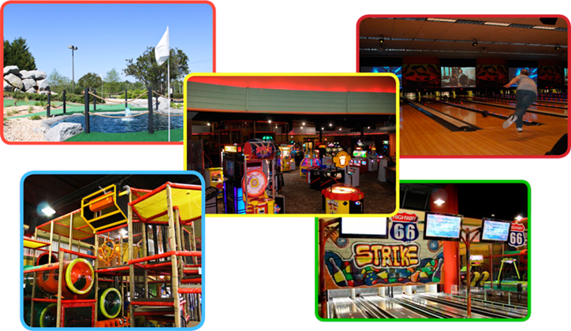
Marching Towards The Future. The Family Entertainment Center Laser Tag Mini-Golf/Driving Ranges Large Game Arcades Batting Cages Go-Karts Rope Courses Sports Bar

Slide 11
Considerations for Adding FEC Attractions Various state inspections Rock climbing walls, go-karts, inflatables, etc. All have specialized certificates/inspections required by the state Specialized employee training on attraction use and safety Additional costs to put in place maintenance contracts to keep up and running Buying new equipment direct from manufacturer or secondhand in used market Many components have shelf life Are historical maintenance logs available? Cords on a bungee trampoline, hydraulic systems on auto-belay, etc.

Slide 12
Considerations for Adding FEC Attractions Space considerations with regards to ROI Some amusements have better ROI than others 20 users per hour @ $5 or 60 users @ $3 Some attractions required dedicated employees adding to overhead Buying through insured and reputable manufacturers and installers Reduces the likelihood that the claim falls back on the center Insurance costs and eligibility

Slide 13
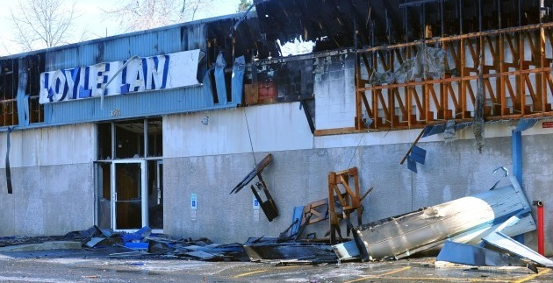
Be Aware When it comes to insurance, no two policies are exactly the same. Here are some tips to keep in mind and watch out for when comparing … Will your liability policy abandon you on certain types of lawsuits? Improper employment practices (sexual harassment claims, wrongful terminations) Key amusement and attraction exclusions (go-karts, laser tag, etc.) Misapplication of employee benefits (401K’s, health insurance plans, etc.) Assault & Battery Coverage exclusions Employee driving and auto-related errands Defense Costs- Outside or In? Will your property claim pay you enough to replace or rebuild? Insufficient property valuations from inexperienced agent advice Co-insurance penalties cutting claim payments in half Hidden deductibles and exclusions Insurer insolvency following natural catastrophes

Slide 14
Common Coverage Gaps For Bowling Centers Underinsurance and coinsurance penalties: It is important to work with your agent to value your building and contents properly and insure for the proper amount. Coinsurance is a penalty imposed on the insured by the insurance carrier for under reporting/declaring/insuring the value of tangible property or business income. The penalty is based on a percentage stated within the policy and the amount under reported. Typically insurance carriers will require you to purchase a policy limit between 80-100% of the value of your property. Submitting a claim may trigger a “coinsurance penalty” if your agent hasn’t recommended the proper coverage values.

Slide 15
Common Coverage Gaps for Bowling Centers Coinsurance as an example: A buildings replacement cost is actually valued at $2,000,000 and has an 90% coinsurance clause but is insured for only $1,500,000. Since its insured value is less than 90% of its replacement value, when it suffers a loss, the insurance payout will be subject to the underreporting penalty. For example, if it suffers a $200,000 loss, the insured would recover $1,500,000 ÷ (0.90 × 2,000,000) × 200,000 = $166,666 (less any deductible). In this example, the underreporting penalty would be $33,333. The most commonly issued coinsurance percentage would be 80% but it can be as high as 100%, which would impose the greatest penalty for underreporting. For this reason, it is vital for values of property to be accurately reported and updated annually to reflect inflation and other increases in cost.

Slide 16
Common Coverage Gaps for Bowling Centers No Employment Practices Liability Insurance (EPLI): EPL Insurance protects against lawsuits brought on by employment related claims such as harassment, discrimination, wrongful termination, failure to employ or promote and much more Small to mid-size businesses are extremely vulnerable to these claims and the costs to defend them can be financially devastating Common Safeguard Endorsements: Your insurance company is accepting and/or pricing your account on the basis of the following functioning systems: Automatic sprinkler system Ansul (Kitchen) fire suppression systems Automatic burglary alarm – protecting the entire building that has a loud sounding gong or siren on the outside of the building

Slide 17
No-Fault Coverage Explained Many liability policies include a “medical expense” limit of anywhere from $1,000 - $5,000 per person. No-Fault coverage means that regardless of who was at fault, it will pay for persons injured on the premises. A small dollar amount to an injured person may prevent a big lawsuit later on. For bowling and family entertainment centers, however, this can be a double-edged sword because small bumps and bruises can occur frequently at the lanes or in another entertainment arena. These amounts do count against the policies claims history for pricing purposes.

Slide 18
Where are the claims coming from?
8 | Building
1 | Business Income
7 | Business Personal Property
2 | Electrical or Power Surge
1 | Freezing Ice
5 | Money/Cash
1 | Mysterious Disappearance
6 | Property
2 | Sewer or Sewage
4 | Theft on Premises
5 | Water- Other

Slide 19
Claims Scenario examples
73 | Bowling- approach slip and fall
3 | Amusement Related- bowling all other
3 | Bowling- Assault
2 | Bowling – equipment malfunction
48 | Bowling – foul line slip and fall
1 | Assault/Battery/Abuse/Molestation (employee related)
2 | Bowling – liquid related slip and fall
3 | Bowling – liquor liability
5 | Bowling – object related slip and fall
61 | Bowling - other
15 | Bowling – outdoor premises slip and fall
57 | Bowling – slip and fall, all other causes

Slide 20
General Liability Coverage Limits How much general liability coverage is enough? Often a tricky question that we should be able to assist with Most commercial insurance policies provide coverage up to $1,000,000 per any one occurrence/2M Aggregate. Umbrella coverage is available at reasonable premiums for coverage well beyond $1M and may be important to consider if your center: Service alcohol or offers BYOB to patrons Contains higher hazard attractions in addition to bowling (such as go-karts , laser tag, inflatables, rock walls, etc.) Jury awards have been growing over time so it is important to consider the limits

Slide 21
General Liability Coverage Limits How much general liability coverage is enough? Often a tricky question that we should be able to assist with Most commercial insurance policies provide coverage up to $1,000,000 per any one occurrence/2M Aggregate. Umbrella coverage is available at reasonable premiums for coverage well beyond $1M and may be important to consider if your center: Service alcohol or offers BYOB to patrons Contains higher hazard attractions in addition to bowling (such as go-karts , laser tag, inflatables, rock walls, etc.) Jury awards have been growing over time so it is important to consider the limits

Slide 22
Tips for Mitigating Exposures Some tips and simple solutions to improve your rating and make your center more attractive to an underwriter: Signage: Make it crystal clear to your patrons THEY ARE NOT ALLOWED TO CROSS THE FOUL LINE AS DOING SO MAY CAUSE INJURY Placement of Signage- At counter, decals and stickers near foul line, gutter, posted on wall, ball returns, etc.) **The warning will reduce the amount of injuries AND provide grounds for denying any frivolous lawsuits Video Cameras: Installing cameras will allow you to have proof of incidents and obtain accurate information * The cameras should capture all foul line activity at each bowling lane. (Recommended retention- policy- 1 year more) Liquor exposure: Make sure all servers are TIPS trained (or equivalent) Consider an ID scanner (**underage drinking is one of the leading causes of liquor related lawsuits) If you hired security personal, make sure they are fully insured (their claims could become YOUR claims if they aren’t)

Slide 23
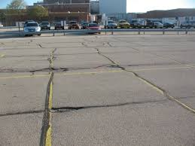
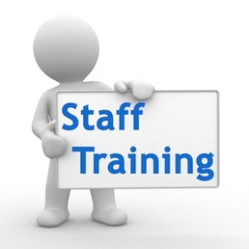
Tips for Mitigating Exposures Housekeeping issues to continue to keep your center at low risk for a loss: Proper lighting in all areas Roof inspections/ maintenance plan Keep lane conditioning product off the approaches Lane Oiling Practices- 18-24inch buffer from foul line recommended Keep potholes in parking lot filled and to a minimum Properly removing snow and treating icy conditions Non slip mats at entrance Marking uneven surfaces (ramps, steps, etc.) Train your staff to watch for spills of drinks

Slide 24
Tips for Mitigating Exposures Educate your staff on key factors when it comes to claims: Gather information for incident reports Bag and tag rental shoes involved in any incidents (evidence) Was it a “stick” or “slip” at the foul line? Are there warning signs clearly posted where the incident happened? Check for debris or spills and be sure to note that on the incident report If there is video evidence, it should be saved immediately Gather names and contact information for witnesses If there is a claim, immediately notify your agent or the carrier

Slide 25
Optional Coverage Considerations Employment Practices Liability Insurance (EPLI) EPL Insurance protects against lawsuits brought on by employment related claims such as harassment, discrimination, wrongful termination, failure to employ or promote and much more. Small to mid-size businesses are extremely vulnerable to these claims and the costs to defend them can be financially devastating. Cost Containment Insurance In snowy areas, you may want to consider cost containment insurance to keep your budget intact for snow removal costs. This seasonal coverage pays for each storm or each inch of snow, excess of an agreed upon threshold. Prize Indemnity Insurance Prize indemnity insurance can be used to attract more tournaments to play at your center by offering them a chance at their participants winning a large cash prize Adds excitement to the tournament or specific theme night You can offer tournament organizers the option to add a “kicker” to their tournament by offering a large cash value (or other prize) for getting a hi/lo/jack, or by getting 3 strikes in a row. Other options are available.

