Slide 1



Total Cost of Your Risk (TCOR)

Slide 2

Presenters
Sean Curtin
SVP of Contingency & SHEL
Tokio Marine HCC – Specialty Group
Chris Price
Principal
Edgewood Partners Insurance Center (EPIC)

Slide 3

Agenda
Who is Tokio Marine HCC
Bowling Program Timeline
Property Risk Management
Liability Risk Management
The Family Entertainment Center
Common Coverage Gaps for Many Bowling Centers
General Liability Coverage Limits
No-Fault Coverage Explained
Optional Coverage Considerations
Your Agent/Brokers
The Quoting Process

Slide 4


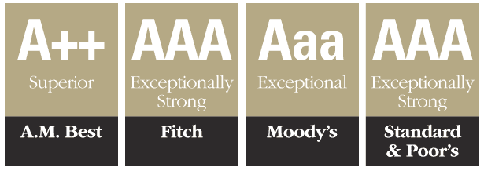
Introduction
Who We Are

Slide 5
Bowling Program Timeline
2011-2013
2014-2015
2016-2018
Initial program startup
Foundations of national market presence
Through 2012 one main distribution partner (ASG/EPIC/StrikeTen – Chris Price)
Growth from true startup to $5.2M+ annual policy premium
Endorsed carrier of BPAA
Growth to $8.7M in policy premium
Addition of several large MUBIG centers
Exit of key markets (NPIC & AIG) and entrance of new players (Scottsdale & NIF)
Growth into FEC hybrid centers and other new construction opportunities
Dedicated loss control personal
  Bowling specific related claims expertise
Admitted product availability
Notes:
Add strike ten logo

Slide 6
In a Perfect World…
You have state of the art equipment.
You have state of the art equipment.
Your building is indestructible, leaving you with no worries when the weather is bad.
Your employees are always on time, trustworthy and courteous.
No one drinks too much.
No one get hurts.
Your customers all comply by the rules.

Slide 7
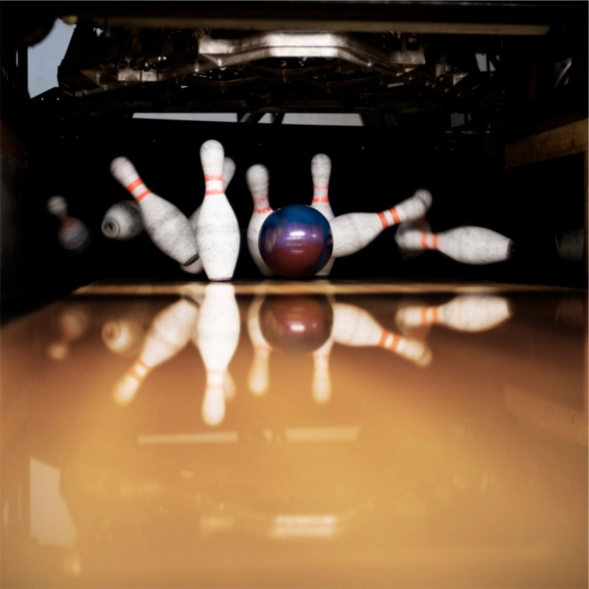
Ok, Let’s Bring it Back to Reality…
Reality is that no one is perfect! That includes us and your bowling centers.
We are here today to help you take a look at the way an underwriter or broker would view your center, and provide you with tips to help improve them as it pertains to your total cost of risk.

Slide 8
What Makes Up a Property Policy?
5 Key Components
Building (How is it valued?)
Equipment Breakdown
Commercial Crime
Business Income
Building Personal Property (BPP)

Slide 9
Building Versus Building Personal Property
What is considered the building & what is considered building personal property?
Building
The building or structure itself. Should include any permanently installed fixtures and equipment
  Lanes
  Ball returns
  Pinsetters
Business Personal Property
All property not included above including stock held for sale
Notes:
Can I / should I, allocate values correctly?
What is the difference in rate? 18%

Slide 10

Be Aware…
No two property policies are exactly the same. When comparing policies, keep in mind:
Under Value Your Property Now=Suffer Later
How will your property policy react?
Will your property claim pay you enough to replace or rebuild?

Slide 11
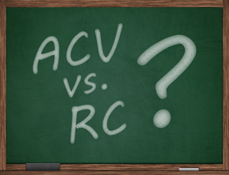
Valuation Types for Bowling Centers
Replacement Cost
Defined as cost to replace the damage property with materials of like kind and quality, without any deduction for depreciation
Actual Cash Value Replacement
Replacement cost, minus the accumulated depreciation for age and condition
Agreed Amount
An endorsement to a policy that waives the coinsurance clause on the specified property

Slide 12
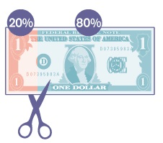
Common Coverage Gap for Bowling Centers
Co-Insurance & Underinsurance
What is best 80% / 90% / 100% co-insurance clause to carry?
Example of Co-Insurance @ 80%: | Building Value@ Time of Loss | Insured Carried | Loss Amount | Insurance Pays
100% to value | $ 5,000,000 | $ 5,000,000 | $150,000 | $150,000
**80% to value min requirement | $ 5,000,000 | $ 4,000,000 | $150,000 | $150,000
Underinsurance | $ 5,000,000 | $ 3,750,000 | $150,000 | $140,625

Slide 13
Common Types of Property Claim Examples
Fire
Lightening
Burglary

Slide 14
Tokio Marine HCC Property Claims Statistics
 | Loss Category | Frequency of Claim | Average Claim Payment
Typical Claims | Burglary | High | $25,000
 | Theft | High | $7,500
 | Vandalism | High | $15,000
 | Mechanical | Med | $35,000
 | Lightening | Med-High | $50,000
 | Vehicle damage | Low-Med | $15,000
Geography Specific | Frozen pipes | Med | $75,000
 | Ice dam | Med | $250,000
 | Other winter weather | Med | $50,000
 | Severe Convective Storm | Med | $250,000
 | Hail | Med | $400,000
 | Other windstorm | Med | $50,000
Catastrophic | Fire | Low | Total loss
 | Collapse | Low | Total loss
 | Tornado | Low | Total loss
 | Hurricane | Low | Total loss
 | Earthquake | Low | Total loss

Slide 15
If I have a total loss can I rebuild elsewhere?
Policy should pay the loss as usual(Remember all carriers not equal). However most property insurance policies do not pay for grading, foundation, underground piping, etc., so most of the issues are moot when dealing with a fire in case of a concrete foundation. However, if the new location had higher taxes, permit costs, etc., we would pay for the prevailing fees at the insured location if they had ordinance and law coverage.
Most Common FAQ on Property Insurance

Slide 16
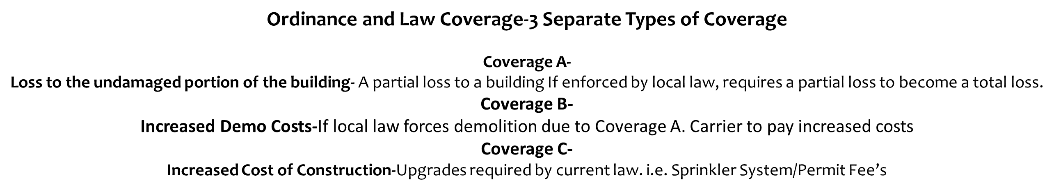
Most Common FAQ on Property Insurance

Slide 17
Bowling Center Property Pricing
Rating
Example Considerations
Past Claims
Start with a base premium (based on the amount of insurance purchased)
Premium discounts or surcharges are then assessed based off specific characteristics
Sprinkler systems
Roofing, plumbing, heating, electrical updates
Hurricane / Tornado exposed area
Example: At a $0.29 rate X $10,000,000 building = $28,595 basic building premium
Construction type
Roof age/maintenance and past claims are the largest factors in pricing
Winter weather protocol
Security systems

Slide 18
What Makes Up a General Liability Policy?
4 Key Components
3rd Party Bodily Injury & Property Damage
Products and Completed Operations
Personal and Advertising Injury
Damage to Rented Premises

Slide 19

General Liability Coverage Limits
How much general liability
coverage is enough?
Standard Limits
Higher Coverage Limit Considerations
$1 Million per occurrence / $2 Million aggregate
BYOB
Higher hazard attractions
State/Jurisdiction

Slide 20
Bowling Center Liability Pricing
Rating
Example Considerations
Start with a base premium (commonly based on receipts)
Premium discounts or surcharges are then assessed based off risk management measures
Risk management practices
Example: At a $8.64 rate X $1,000,000 in revenue = $8,642 premium
Attractions on premises
Cleaning & maintenance logs
Liquor certifications
Signage
Lane conditioning
FYI: Adding attractions may drive up premiums, but good risk management
procedures can help keep numbers down.

Slide 21
Common Liability Claim Examples
Slip & Fall Over the Line
Laser Tag Collision
Liquor Related (i.e. DUI)

Slide 22
Tokio Marine HCC Liability Claims Statistics
 | Loss Category | Frequency of Claim | Average Claim Payment
Bowling Related | Slip & fall - approach sticky | Med-High | $75,000
 | Slip & fall – over the line | High | $15,000
 | Slip & fall – finger stuck in ball | Med | $10,000
 | Ball return related | Low-Med | $100,000
General Premise | Interior – water/puddle | Med | $150,000
 | Interior – bathroom | Low-Med | $25,000
 | Interior – uneven surface | Med | $100,000
 | Interior – chairs/tables | Med | $25,000
 | Interior – ball racks | Low | $50,000
 | Exterior – potholes | Med-High | $100,000
 | Exterior – snow/ice | Med | $75,000
Catastrophic | Misc. fight/assault | Low-Med | $250,000+
 | Liquor, DUI | Low-Med | $1,000,000+
 | Severe violence | Low | $1,000,000+
 | Abuse & molestation accusation | Low | $1,000,000+

Slide 23
Most Common FAQ on General Liability?
What is Med Pay no Fault Coverage?
“Medical Expense” limits
May prevent bigger lawsuits brought on later
Count against claims history

Slide 24
Considerations for Adding “Fun Center” Attractions
Various State Inspections
Specialized Employee Training
Buying Used Equipment
Other Considerations:
Space
Reputable Manufacturers & Installers
Insurance Costs & Eligibility

Slide 25
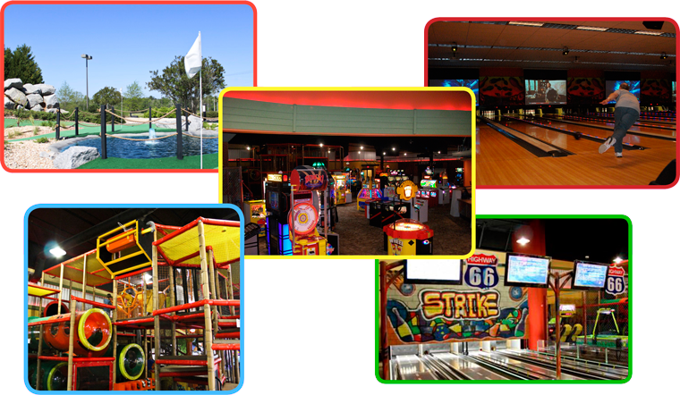
The Family Entertainment Center Exposures
Laser Tag
Mini-Golf/Driving Ranges
Billiards
Arcades
Batting Cages
Go-Karts
Roller Skating
Zip Lining
Ropes Courses

Slide 26
Base Rate Pricing
Ancillary Exposures & Their Ratings
Base
Ball Pits | Sales | $9.00
Batting Cages | Sales | $8.50
Billiards/Darts | Sales | $3.00
Bowling | Sales | $6.21
Bumper Boats | Sales | $10.00
Bumper Cars | Sales | $9.50
Camps | Each | $2.00
Driving Range | Sales | $5.50
Food | Sales | $1.94
Go-Karts | Sales | $11.00
Horseshoes | Sales | $2.00
Ice Skating | Sales | $8.00

Slide 27
Optional Coverage Considerations
Employment Practices Liability
Cost Containment Insurance
Prize Indemnity Insurance

Slide 28

Employment Practices Liability Insurance (EPLI)
What is EPLI coverage?
Provides protection for any employer against claims made by employees, former employees or prospective employees alleging:
  Harassment
  Discrimination
  Wrongful termination
  Retaliation
  Other inappropriate employment conduct
Cost Structures
Limit options available $50k, $100k, $250k
Rates based off employee count
Premium includes full prior acts and coverage for punitive damages

Slide 29
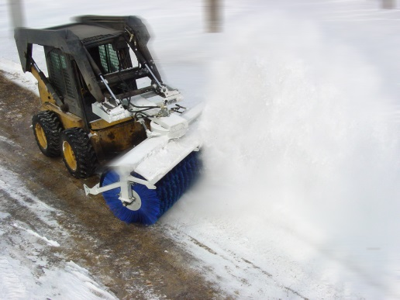
Cost Containment Weather Insurance
What is Cost Containment ?
Designed to limit costs associated with abnormal weather conditions
  Snow removal expenses in abnormally snowy winter
  Heating costs in a cold/prolonged winter
  Cooling costs in a hot/prolonged summer
Seasonal coverage responds to pay for every inch of snow or degree above the selected threshold of deductible amount

Slide 30
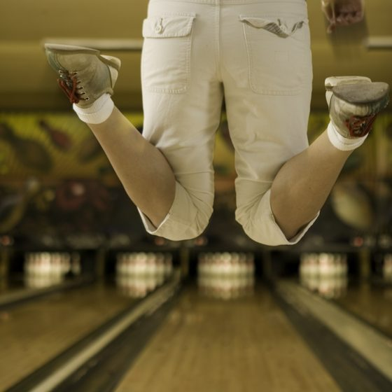
Prize Indemnity Insurance
What is an Insured Promotion?
Enables promoters or sponsors to offer a large prize, risk-free for a premium that is a fraction of the prize value
Protects your budget by transferring the risk of someone winning a large prize or over-redeeming a free product offer or coupon
Types of Bowling Promotions:
300 Game for $300K
7-10 Split for a New Car

Slide 31

The Role of Your Agent/Broker
Provides Quote Comparisons
Makes Recommendations
Obtains Necessary Information for Insurance Carriers
Assists in Claim Situations
Educates You

Slide 32
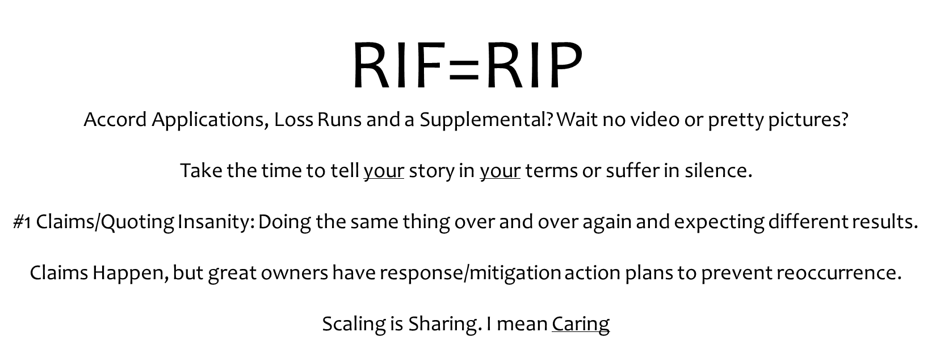
How Should a Broker Position you for Greatness?

Slide 33

Tips for you to Simplify the Quoting Process
Database your information
Request loss runs
Complete supplemental applications
Submit everything 60 days prior to your expiration date

Slide 34

Questions or Comments?

